Slide 1
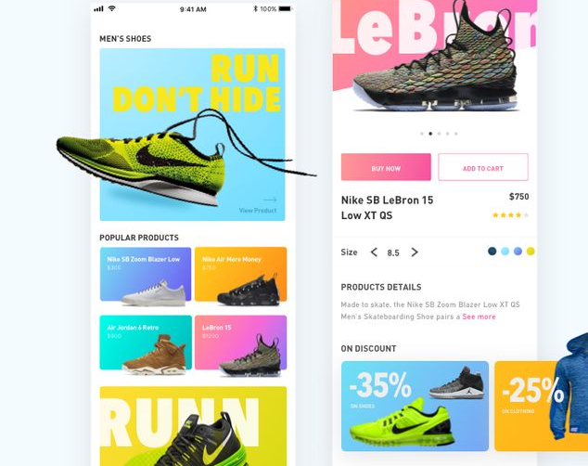
Nike Store eCommerce Website
A Seamless Online Shopping Experience
Abu Bakar Marah

Slide 2
Description
The web application developed is an eCommerce website for a Nike Store. Its purpose is to provide users with a seamless online shopping experience for Nike products, including various shoe models like Air Force, Air Jordan, Blazer, Crater, and Hippie. The target audience includes sneaker enthusiasts and general consumers looking for high-quality Nike footwear. Unique features include a dynamic product slider, a shopping cart with real-time updates, a responsive design, and a login/signup modal for user authentication.

Slide 3

Tech Stack
HTML: For structuring the content of the web pages.
CSS: For styling the web pages and ensuring a responsive design.
JavaScript: For adding interactivity, such as the product slider, shopping cart functionality, and modals.

Slide 4
Project Link
Live Version: Nike Store Live (file:///Users/abubakarrmarah/Web%20Development/ECOMMERCE/index.html)
GitHub Repository: GitHub Repo (Replace with actual link)

Slide 5
JavaScript Enhancements
Email Notification
// Email Notification
const emailNotification = document.querySelector(".emailNotification");
const closeEmailNotification = document.querySelector(".closeEmailNotification");
function showEmailNotification() {
emailNotification.style.display = "flex";
}
closeEmailNotification.addEventListener("click", () => {
emailNotification.style.display = "none";
});
// Simulate email notification on checkout
checkoutButton.addEventListener("click", () => {
payment.style.display = "none";
showEmailNotification();
});
Email Notification: Show email notification modal on checkout

Slide 6

Code Quality
Strengths: The code is well-organized and commented, making it easy to follow. Consistent indentation and formatting are maintained across HTML, CSS, and JavaScript files.
Improvements: Modularize the JavaScript code by separating concerns into different functions or modules. This will improve maintainability and scalability.

Slide 7

Key Areas for Improvement
User Authentication: Adding a more robust user authentication system with profile management.
Search Functionality: Implementing a search feature to allow users to quickly find products.
Additional Suggestion
Wishlist Feature: Allow users to save products to a wishlist for future purchases.
Product Reviews: Enable users to leave reviews and ratings for products.
Enhanced Animations: Add more animations and transitions to improve the overall user experience.

Slide 8



Thank You

